Slide 1

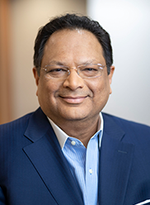
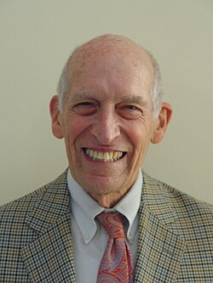
American Association of Indian Pharmaceutical Scientists
AAiPS
Annual Gala Dinner Meeting
In conjunction with AAPS 2026 Pharm SCi 360
October 27, 2026 @ 5:30 pm to 9:30
Nirvana Restaurant, 4308 Magazine Street,
New Orleans.
Chief Guest: Mr. Ketan Mehta
Founder & CEO
Tris Pharma Inc, New Jersey.
Guest of Honor: Prof. Leslie Z. Benet, Ph.D.
Chair Dept. of Biopharmaceutical Sciences, USCF
Founder & First President AAPS.

Slide 2

American Association of Indian Pharmaceutical Scientists
AAiPS
Annual Gala Dinner Meeting
In conjunction with AAPS 2026 Pharm SCi 360
October 27, 2026 @ 5:30 pm to 9:30
Nirvana Restaurant, 4308 Magazine Street,
New Orleans.
Register online to reserve your spot today @aaips.org

